Slide 1
TOPIC 10.6
CARBOXYLIC ACIDS
AND DERIVATIES

Slide 2


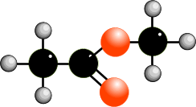
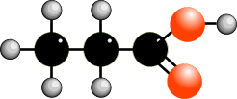
INTRODUCTION
• contain the carboxyl group (COOH group)
• are isomeric with esters :- RCOOR’

Slide 3
PHYSICAL
PROPERTIES

Slide 4
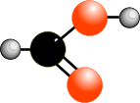
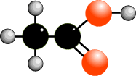

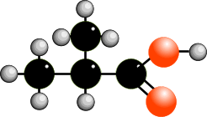
BOILING POINT
Increases as size increases - due to increased van der Waals forces
101°C 118°C 141°C 164°C
Boiling point is higher for “straight” chain isomers.
164°C 154°C
Greater branching = lower inter-molecular forces = lower boiling point

Slide 5
BOILING POINT
Carboxylic acids have relatively high boiling points
REASON : strong hydrogen bonding between molecules.
The boiling point is higher than that of alcohols of similar M_{r}.
e.g. Mr b.p. (ºC)
CH₃COOH 60 118
CH₃CH₂CH₂OH 60 97
REASON : the H bond in carboxylic acid is stronger than that
in alcohol due to the highly polar nature of COOH
group.

Slide 6
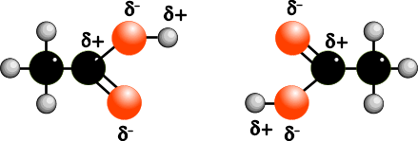
BOILING POINT
Many carboxylic acids (particularly the lower one),
exist as dimers in the liquid state and in non-polar solvents
and to some extent, in the vapour phase.
The dimerisation occurs through H bonding.
HYDROGEN BONDING
DIMERISATION

Slide 7
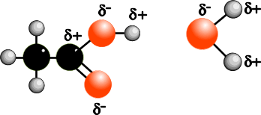
SOLUBILITY
• carboxylic acids are soluble in organic solvents
• they are also soluble in water due to hydrogen bonding
• small ones dissolve readily in cold water
• as mass increases, the solubility decreases
• benzoic acid is fairly insoluble in cold but soluble in hot water
HYDROGEN BONDING

Slide 8
FORMATION OF CARBOXYLIC ACIDS
OXIDATION OF 1º ALCOHOL
Reagent : KMnO₄ in H₂SO₄ or K₂Cr₂O₇ in H₂SO₄
Condition : reflux / heat
e.g.
OXIDATION OF ALDEHYDES
Reagent : KMnO₄ in H₂SO₄ or K₂Cr₂O₇ in H₂SO₄
Condition : reflux / heat
e.g.

Slide 9
FORMATION OF CARBOXYLIC ACIDS
HYDROLYSIS OF NITRILES
Acidic Hydrolysis
Reagent : dilute H₂SO₄ / H₂SO₄ (aq)
Condition : reflux / heat

Slide 10
FORMATION OF CARBOXYLIC ACIDS
HYDROLYSIS OF NITRILES
Alkaline Hydrolysis
Reagent : dilute NaOH / NaOH(aq)
Condition : reflux / heat
The acid can be liberated from its salt by treatment with a stronger acid.
e.g. RCOO¯ Na⁺(aq) + HCl(aq) ——> RCOOH + NaCl(aq)
Conversion of an acid to its water soluble salt followed by acidification of
the salt to restore the acid is often used to separate acids from a mixture.

Slide 11
CHEMICAL
PROPERTIES

Slide 12
FORMATION OF SALTS
Carboxylic acid reacts with bases, carbonates and metals to form salts.
e.g.

Slide 13
ESTERIFICATION
Reagent : Alcohol
Condition : Reflux, conc. H₂SO₄ ( catalyst)
Product : Ester
e.g.

Slide 14
REDUCTION
Reagent : NaBH_{4(aq)} or LiAlH₄ in dry ether
Product : Aldehyde

Slide 15
ESTER

Slide 16
INTRODUCTION
Structure - Substitute an organic group for the H in carboxylic acids
Nomenclature - first part from alcohol, second part from acid
e.g. methyl ethanoate CH₃COOCH3
Molecular formula - same as carboxylic acids (structural isomers)
[ but are neutral ]
METHYL ETHANOATE
METHYL ETHANOATE

Slide 17
INTRODUCTION
Preparation - Esterification
Physical properties - lower boiling points than carboxylic acids.
- insoluble in water.
- sweet smelling liquid.

Slide 18
HYDROLYSIS OF ESTERS
HYDROLYSIS IS THE OPPOSITE OF ESTERIFICATION
Esters are readily hydrolysed by heating under reflux with acid or base
Acidic Hydrolysis
Condition : reflux with dilute H₂SO₄
Product : Alcohol and carboxylic acid
e.g.

Slide 19
HYDROLYSIS OF ESTERS
HYDROLYSIS IS THE OPPOSITE OF ESTERIFICATION
Esters are readily hydrolysed by heating under reflux with acid or base
Alkaline Hydrolysis
Condition : reflux with aqueous NaOH
Product : Alcohol and sodium salt of the carboxylic acid
e.g.

Slide 20
USES OF ESTERS
Despite being fairly chemically unreactive, esters are useful as ...
1) • flavourings apple 2-methylbutanoate
pear 3-methylbutylethanoate
banana 1-methylbutylethanoate
pineapple butylbutanoate
rum 2-methylpropylpropanoate
• solvents nail varnish remover - ethyl ethanoate
2) - make soap
- as polymer (terylene)

